Slide 1
Curves Design
南开大学软件学院
王 靖

Slide 2
Outlines
Develop tools for design curves
Determine key properties of curves, such as “smoothness”
Bezier curves and B-spline curves

Slide 3
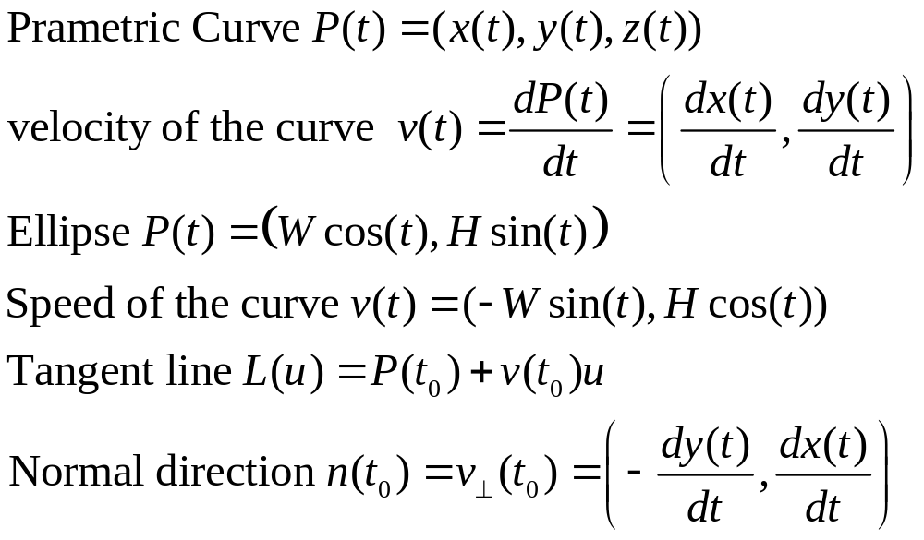
Smoothness of the curve

Slide 4
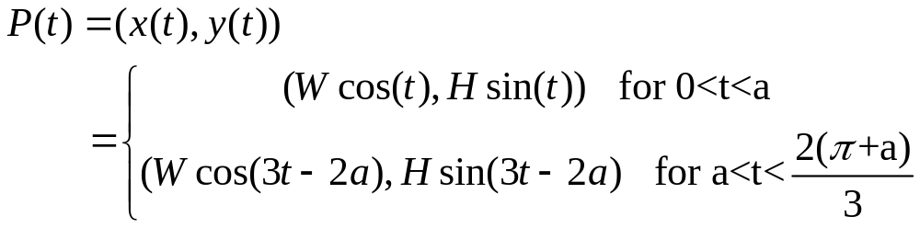
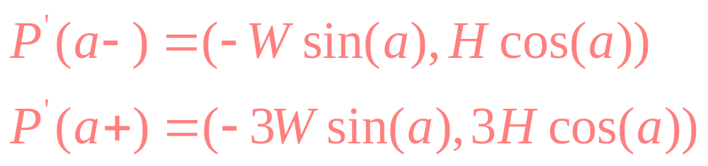
Smoothness of the curve

Slide 5
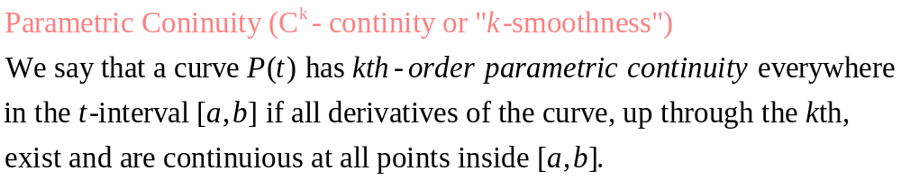
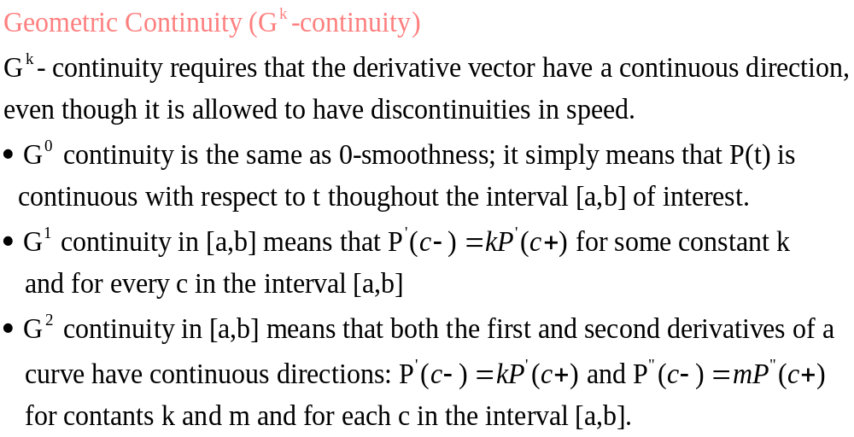
Smoothness of the curve

Slide 6
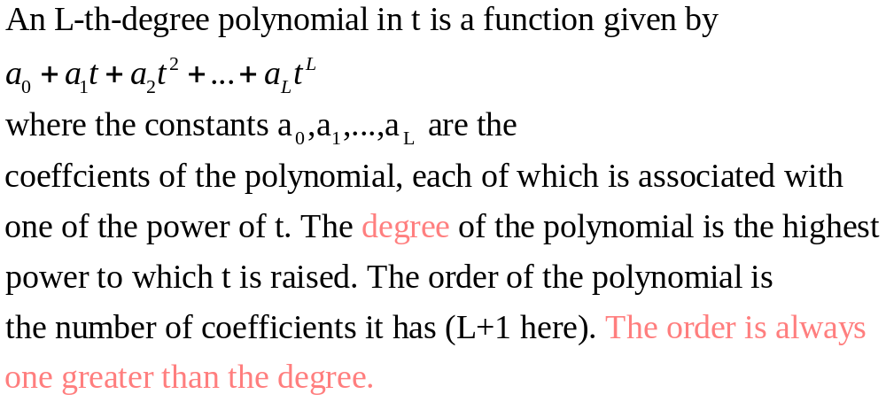
Polynomials Curves

Slide 7
Interactive Curve Design
Control Points:
P₀ P₁ ,…...P_{L}
Curve-generation
algorithm
P(t)
any t
The curve interpolates
the control points
The curve approximates
the control points

Slide 8
Bezier curves for curve design (de Casteljau Algorithm)
P1
F(1)
Linear (Degree 1, Order 2)
F(0) = P0, F(1) = P1
F(u) = ?
F(u)
P0
P0
P1
F(0)
1-u
u
F(u) = (1-u) P0 + u P1

Slide 9
Bezier curves for curve design: Quadratic Bezier Curve
u
1-u
u
1-u
u

Slide 10
Bezier curves for curve design: Quadratic Bezier Curve
P1
Quadratic
Degree 2, Order 3
F(0) = P0, F(1) = P2
F(u) = ?
P0
P2
P0
P1
P2
1-u
u
1-u
u
1-u
u
F(u) = (1-u)² P0 + 2u(1-u) P1 + u² P2

Slide 11
Bezier curves for curve design: Cubic Bezier Curve
u
u
u
u
u
u

Slide 12
Bezier curves for curve design: Cubic Bezier Curve
P1
P2
Cubic
Degree 3, Order 4
F(0) = P0, F(1) = P3
P0
P3
P0
P1
P2
P3
1-u
u
1-u
u
1-u
u
1-u
u
1-u
u
1-u
u
F(u) = (1-u)³ P0 +3u(1-u)² P1
+3u²(1-u) P2 + u³ P3

Slide 13
Summary: deCasteljau Algorithm
P1
P2
P1
P1
P2
P0
P3
P0
P0
Cubic
Degree 3, Order 4
F(0) = P0, F(1) = P3
Quadratic
Degree 2, Order 3
F(0) = P0, F(1) = P2
Linear
Degree 1, Order 2
F(0) = P0, F(1) = P1
P0
P1
P2
P3
P0
P1
P2
1-u
u
1-u
u
1-u
u
P0
P1
1-u
u
1-u
u
1-u
u
1-u
u
1-u
u
1-u
u
1-u
u
F(u) = (1-u) P0 + u P1
F(u) = (1-u)² P0 + 2u(1-u) P1 + u² P2
F(u) = (1-u)³ P0 +3u(1-u)² P1
+3u²(1-u) P2 + u³ P3

Slide 14
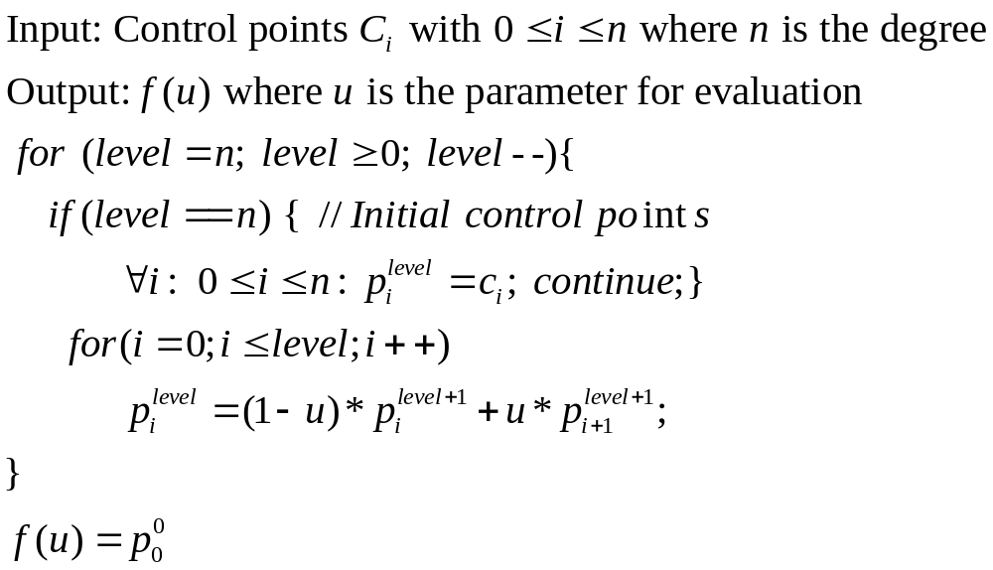
deCasteljau Algorithm Implementation

Slide 15
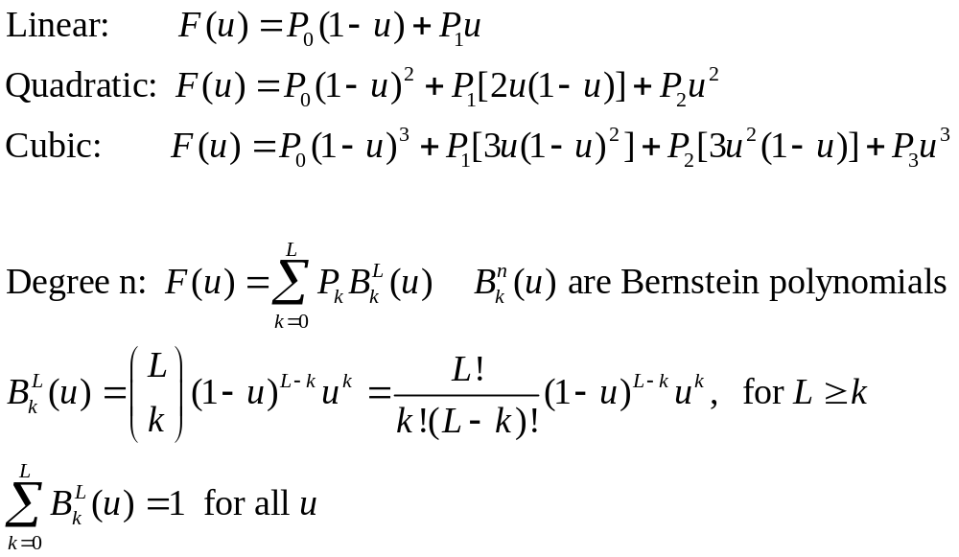
Bezier Curve with degree n

Slide 16
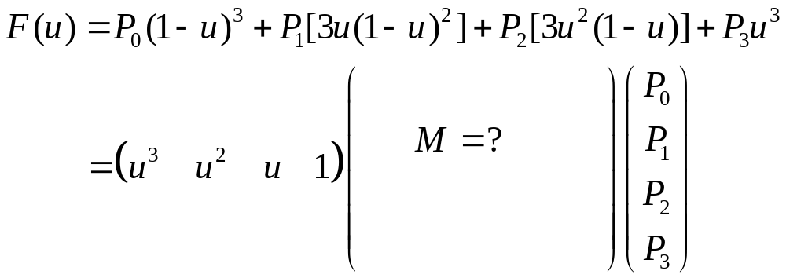
Matrix formalization of Bezier Curve

Slide 17
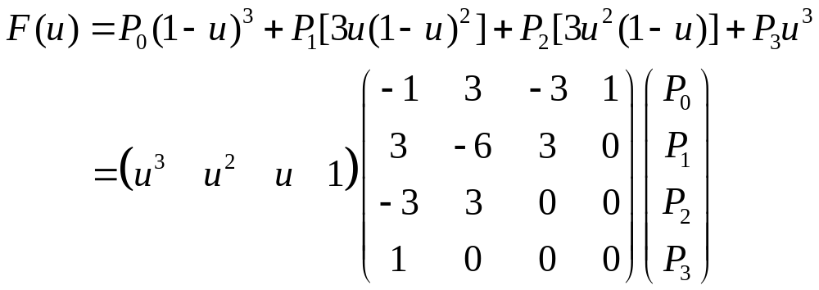
Matrix formalization of Bezier Curve

Slide 18
Properties of Bezier Curves
Endpoint Interpolation: It always interpolates P0 and PL
Affine Invariance: they are formed as an affine combination of points
Convex-hull property: never wanders outside its convex hull, because
Bernstein polynomial is always non-negative.
Linear Precision: If all of the control points are placed in a straight line,
their convex hull collapses to a line
Variation-diminishing Property: Can’t “fluctuate” more than their control
polygon does.
Degree of the Bernstein used is coupled to the number of
control points. L+1 control points is a combination of
L-degree polynomials.
No Local Control!

Slide 19




Blending Functions
1
The Bernstein polynomials of degree 3

Slide 20
Wish list for Blending Functions
Be easy to compute and numerically stable
Sum to unity at every t in [a,b]
Have support only over a small portion
Interpolate certain control points
Be smooth enough to produce a desirable shape

Slide 21
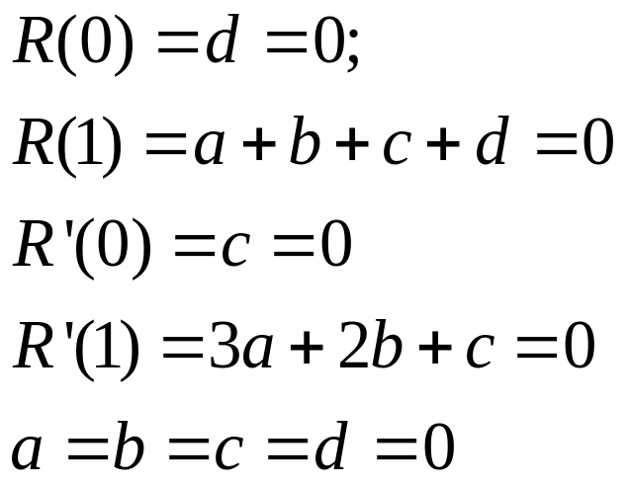
Piecewise Polynomial Curves and Splines
Is this a cubic
polynomial?
1

Slide 22
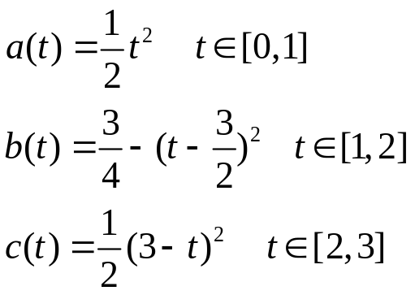
Piecewise Polynomial Curves and Splines
Piecewise polynomials
B(t)
3/4
1/2
Span
C(t)
A(t)
knot
The points at which a pair of the
Individual segments meet are called joins,
and the values of t at which this happens
are called knots.
1
2
3
Definition of a Spline Function:
An Mth-degree function is a piecewise polynomial of degree M that is (M-1)-
Smooth at each knot.

Slide 23




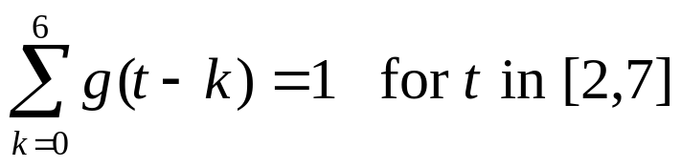
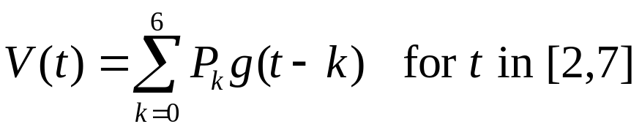
Spline Blending Functions
0.75
0.5
1
2

Slide 24
Spline Blending Functions
P₄
P₂
t=4
t=6
t=3
t=5
P₁
P₃
P₅
t=2
t=7
P₆
P₀
How to close the curve?

Slide 25
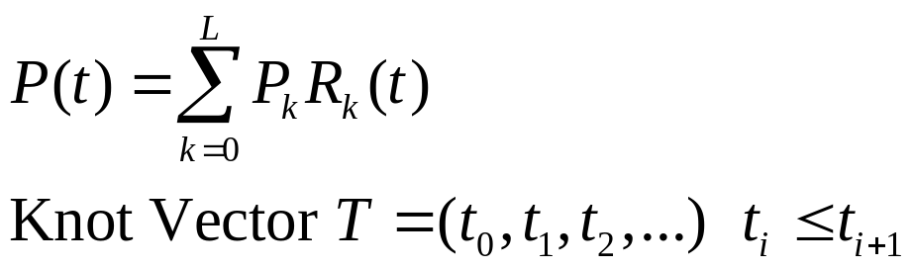
Spline Curves and Basis Functions
R₁(t)
R₂(t)
R₀(t)
R₃(t)
t₀
t₁
t₂
t₃
t₄
t₅
t₆
t₇
Knot vector
Bezier One Span from 0 to 1.
Polynomials are of degree
L, there are L+1 knots at t=0
and L+1 more knots at t=1.
Translates of g(t) The knot values are
The integers 0,1,…,L+2, and each
Translate g(t-k) is a spline consisting
Of three polynomials of degree 2.

Slide 26
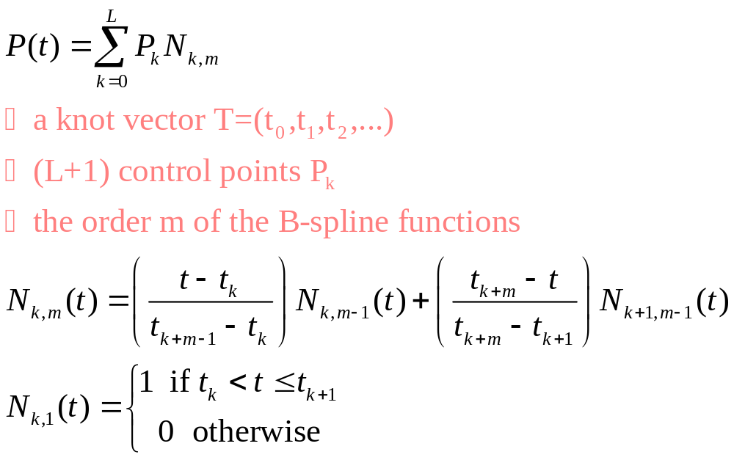
The B-spline basis functions

Slide 27



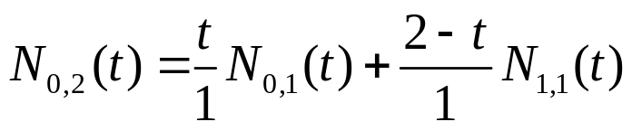

Linear B-splines
1
1
t
2-t
1
2
1
2

Slide 28



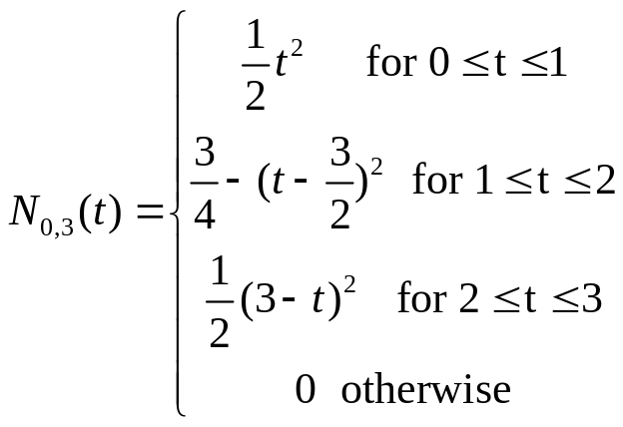
Quadratic B-spline
1
2
3
4
1
2
3
http://www.ibiblio.org/e-notes/Splines/Basis.htm

